Slide 1


FPGA Reliability and Security
Ahmed Foisal , Mian Riaz-ul-Haque, Islam Syful, Michihiro Shintani
Graduate School of Information Science,
Nara Institute of Science and Technology (NAIST)
Japan.

Slide 2

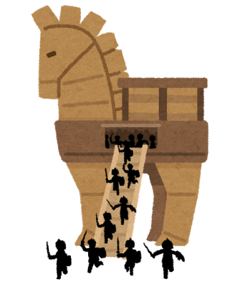
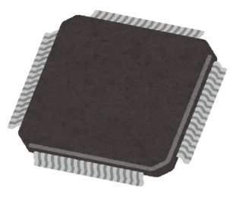
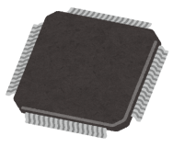
Background
FPGA is a modern reconfigurable platform
Recently concern reliability and security issues due to
Hardware Trojan (HT)
Manufacture
Retailer
User
Counterfeit
UNRELIABLE
✔
system
✔
Attacker

Slide 3
Motivation
Detect the counterfeit FPGA and HT
Protect the critical applications i.e. medical, nuclear plant, defence etc. from catastrophic conditions.

Slide 4

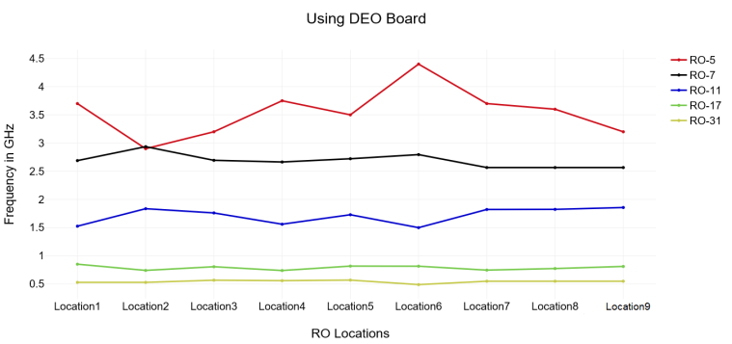
Proposed System Design
FPGA is used
Fast analysis
Graphical output
Machine learning based
Host PC
Master FPGA
Device under analysis

Slide 5
Business Impact and Analysis
Importance
Risk in critical applications
Economic Impact
Industry reputation
Target user
FPGA Manufacturer
FPGA application based company
End user
Strength
Weakness
Low area coverage
Same ring oscillator (RO) with different locations
With different physical conditions ( temperature or Voltage)
RO with various internal architecture
Path delay
Machine learning
Threats
New technology for counterfeiting and HT insertion
Opportunity
Artificial Intelligence
Scalability
End user demand

Slide 6

Question and Answer

